Slide 1

Unity's Physics Engine: Rigid Bodies and Forces

Slide 2
Learning Objectives
Understand the fundamentals of Unity's Physics Engine
Explore the concept of rigid bodies in game development
Learn how forces affect objects in a virtual environment

Slide 3
Content
Introduction to Unity Physics Engine
Rigid Bodies in Unity
Forces and Their Application
Advanced Physics Concepts

Slide 4
Unity Physics System Overview
Unity Physics is a robust and highly customizable physics simulation system integrated into the Unity game development engine.
It enables developers to create realistic and immersive virtual environments by simulating physical interactions between game objects.
Key Components: Collider and Rigidbody
Collision Detection and Resolution: identify when two objects intersect and respond to collisions, bouncing, or triggering specific actions.
Layers and Masks: employed to control which objects interact with each other.
Forces and Interactions: Simulates the force of gravity on objects and specific actions, such as explosions or wind.
Constraints and Joints: limit the movement of objects, providing stability or creating specific behaviors; and connect objects, allowing them to move in relation to each other, facilitating complex physical simulations.
Image source: Unity.com

Slide 5
Unity Physics System Overview
Key Components:
Collider Components: Shapes that define the physical boundaries of game objects, allowing the Unity Physics Engine to perform collision detection and response.
Box Collider:
Represents a rectangular prism or cube.
Ideal for objects with simple geometric shapes.
Sphere Collider:
Represents a spherical shape.
Suitable for objects like balls or other round entities.
Capsule Collider:
Represents a capsule or cylinder with hemispherical ends.
Useful for modeling characters or other elongated shapes.
Image source: Unity.com

Slide 6
Unity Physics System Overview
Key Components:
Mesh Collider:
Uses the actual mesh of a 3D model as the collider.
Provides precise collision representation but can be computationally expensive.
Wheel Collider:
Specifically designed for simulating vehicle wheels.
Enables realistic wheel interactions with terrain.
Terrain Collider:
Designed for terrains created with Unity's terrain system.
Allows for efficient collision detection with terrain features.
Composite Collider 2D:
Used in 2D physics to optimize collision detection for complex shapes.
Combines multiple colliders into a single collider for improved performance
Image source: Unity.com

Slide 7
Collision Detection and Resolution
Collision detection and resolution are fundamental concepts in game development that involve determining when two objects intersect (collision detection) and responding appropriately to that intersection (collision resolution). Unity's physics engine handles these aspects through the use of collider components and the Rigidbody component.
Image source: Unity.com

Slide 8
Collision Detection
Broad-Phase Collision Detection:
Unity uses an efficient broad-phase collision detection algorithm to quickly identify potential collisions among a large number of objects.
This phase narrows down the possible collisions to a smaller subset of potential pairs.
Narrow-Phase Collision Detection:
The narrow-phase collision detection involves a more detailed examination of potential collision pairs to determine if they are indeed colliding.
Unity checks the precise shapes defined by the colliders to establish whether and where the collision occurs.
Trigger Colliders:
Some colliders can be set as triggers, meaning they detect collisions without physically interacting with other objects.
Trigger colliders can be used for events, scoring, or other non-physical interactions.
Image source: Unity.com

Slide 9
Collision Resolution
Physics Materials:
Colliders can have physics materials assigned to them, influencing how objects react upon collision.
Physics materials can control parameters like friction, bounciness, and sound effects.
Impulse and Force:
When a collision is detected, Unity applies forces or impulses to the colliding objects to simulate their reaction.
The Rigidbody's mass and velocity determine how much an object responds to a collision force.
Image source: Unity.com

Slide 10
Collision Resolution
Collision Events:
Unity provides collision events that can be utilized in scripts to trigger specific actions when collisions occur.
OnCollisionEnter, OnCollisionStay, and OnCollisionExit are commonly used events.
Collision Layers and Masks:
Unity allows developers to define collision layers and masks to control which objects can collide with each other.
This feature provides fine-grained control over collision interactions.
Continuous Collision Detection (CCD):
Unity supports Continuous Collision Detection, which helps prevent fast-moving objects from passing through each other without detection.
CCD ensures that collisions are detected even when objects are in rapid motion.
Image source: Unity.com

Slide 11
Collision Resolution
Physics Material Combine:
When two colliders with physics materials collide, Unity combines the properties of the materials to determine the overall collision response.
Collision Resolution Strategies:
Developers can implement custom collision resolution strategies through scripting to handle specific scenarios or game mechanics.
Image source: Unity.com

Slide 12
Rigid Bodies in Unity
In Unity, rigid bodies are components used to simulate physics interactions for GameObjects. A rigid body is typically attached to a GameObject that needs to exhibit realistic physical behavior, such as responding to forces, collisions, and gravity. Here's an overview of rigid bodies in Unity:
1. Adding a Rigidbody:
To use a rigid body, you need to attach it to a GameObject. Select the GameObject in the Unity Editor and add a Rigidbody component through the Inspector window.
2. Properties of Rigidbody:
Mass: Represents the amount of matter in the object. Heavier objects require more force to accelerate.
Drag: Simulates air resistance, affecting how quickly an object comes to rest when no forces are applied.
Angular Drag: Resists rotational motion and affects how quickly an object stops rotating.
Use Gravity: Determines whether the object is affected by gravity.
Image source: Unity.com

Slide 13
Rigid Bodies in Unity
3. Interactions with Forces:
Rigidbodies respond to forces applied through scripts or Unity's physics engine.
Forces can be applied in various directions and magnitudes, influencing the object's linear and angular motion.
4. Collision Detection:
Rigidbodies are essential for enabling collision detection and response in Unity.
When two objects with Rigidbody components collide, Unity's physics engine calculates and handles the resulting forces and interactions.
5. Velocity and Angular Velocity:
Velocity: Represents the linear speed of the object in 3D space.
Angular Velocity: Represents the rotational speed of the object.
Image source: Unity.com

Slide 14
Rigid Bodies in Unity
6. Constraints:
Rigidbody supports constraints to limit certain movements, such as freezing rotation along specific axes.
Constraints provide control over the object's degrees of freedom.
7. Kinematic Mode:
Rigidbodies can be set to kinematic mode, which means their movement is controlled programmatically rather than by physics.
In kinematic mode, objects can still trigger collisions but don't respond to external forces.
8. Sleeping Mode:
Rigidbodies have a sleeping mode to optimize performance.
When an object is at rest, Unity's physics engine can "sleep" the Rigidbody, reducing unnecessary calculations until a force is applied.
Image source: Unity.com

Slide 15
Rigid Bodies in Unity
9. Continuous Collision Detection (CCD):
Rigidbodies support Continuous Collision Detection, preventing fast-moving objects from passing through each other without detection.
10. Use Cases:
Rigidbodies are commonly used for simulating realistic interactions, such as character movement, object physics, and vehicle dynamics.
Example Code: demonstrates a simple script attached to a GameObject with a Rigidbody. It applies an upward force when the space bar is pressed.
Image source: Unity.com

Slide 16
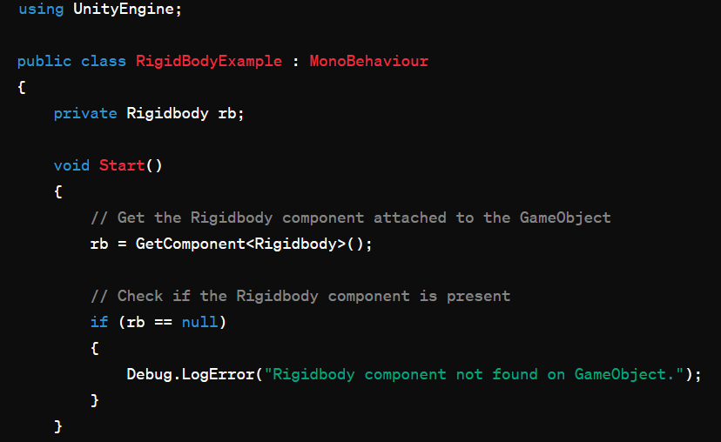
Rigid Bodies in Unity
Image source: Unity.com

Slide 17
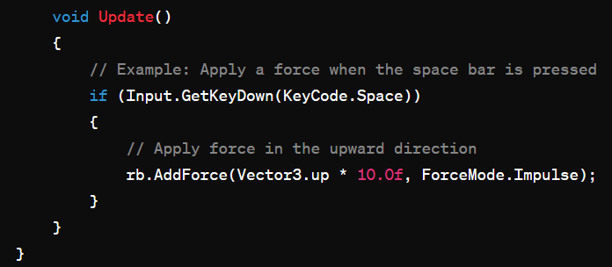
Rigid Bodies in Unity
Image source: Unity.com

Slide 18
Forces and Their Application
Forces play a crucial role in simulating realistic physics interactions within a Unity game or simulation. In Unity, forces can be applied to GameObjects with Rigidbody components to influence their motion.
1. Force Application:
Forces in Unity are typically applied to objects with Rigidbody components.
The AddForce method is commonly used to apply forces to a Rigidbody.
Example: Apply a force in the forward direction
rb.AddForce(transform.forward * forceMagnitude, ForceMode.Force);
2. Force Modes:
Unity provides different ForceModes to control how forces are applied. Common modes include:
Force: Applies a continuous force over time.
Impulse: Applies an instantaneous force.
Acceleration: Applies continuous acceleration.
Velocity Change: Applies an instant change in velocity.
Image source: Unity.com

Slide 19
Forces and Their Application
3. Custom Forces:
Developers can create custom force vectors to simulate specific actions, such as wind, explosions, or character movements.
Forces are vectors, and their direction and magnitude determine their effect.
Example: Apply a custom force vector
Vector3 customForce = new Vector3(1.0f, 0.0f, 0.0f);
rb.AddForce(customForce * forceMagnitude, ForceMode.Force);
4. Gravity:
Unity's physics engine includes built-in gravity that affects objects with Rigidbody components.
Gravity can be disabled or modified for specific objects.
// Example: Disable gravity for the object
rb.useGravity = false;
Image source: Unity.com

Slide 20
Forces and Their Application
5. Torque:
Torque is a rotational force that influences an object's angular motion.
It can be applied using the AddTorque method.
Example: Apply torque around the up axis
rb.AddTorque(Vector3.up * torqueMagnitude, ForceMode.Force);
6. Combining Forces:
Multiple forces can be combined to create complex interactions.
For example, a character controller might combine forces for walking, jumping, and responding to external influences.
7. Drag and Angular Drag:
Drag simulates air resistance and affects an object's linear motion.
Angular drag affects rotational motion.
These properties can be adjusted to control the rate at which an object slows down.
Image source: Unity.com

Slide 21
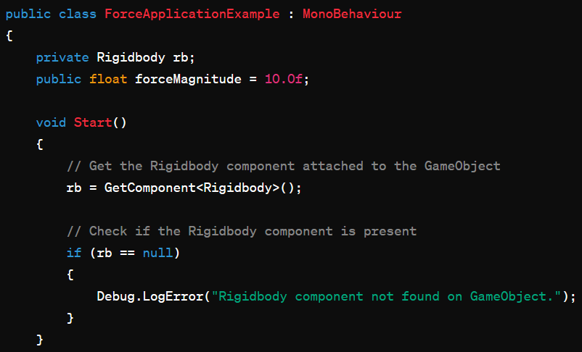
Forces and Their Application
Example Code:
Here's a simple script that demonstrates the application of forces to a GameObject with a Rigidbody:
Image source: Unity.com

Slide 22
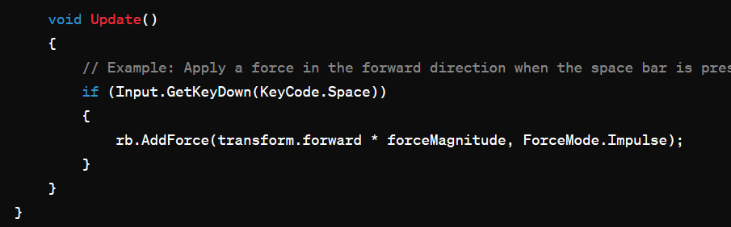
Forces and Their Application
Image source: Unity.com

